Slide 1
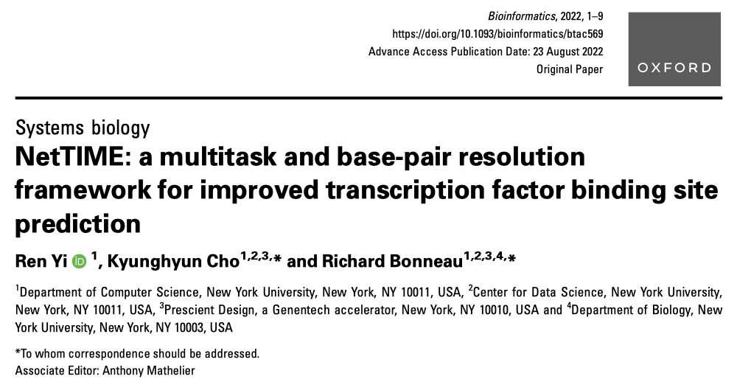
Paper report
Cheng-Hsuan Wu
Oct 19, 2022

Slide 2
Outline
Background
noncoding dna
Computational approach to binding prediction
Motivation
Related work
Data
Tech
Result

Slide 3
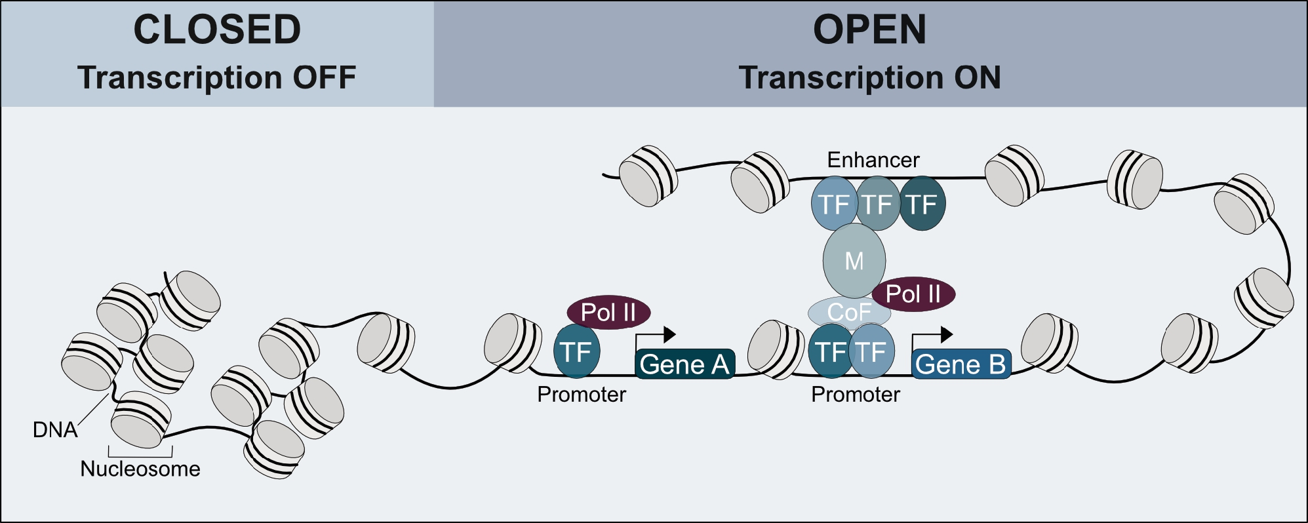
Modeling of non-coding DNA sequence
Transcriptional regulation is orchestrated by transcription factors
Both the cell-type specific chromatin state and the DNA sequence affect the interactions between TFs and DNA in vivo
Computational methods are essential for less well-known TFs and cell types
Leiz, J., Rutkiewicz, M., Birchmeier, C., Heinemann, U. & Schmidt-Ott, K. M. Technologies for profiling the impact of genomic variants on transcription factor binding. Medizinische Genetik 33, 147–155 (2021).
Notes:
Genome-wide modeling of non-coding DNA sequence function is among the most fundamental and yet challenging tasks in biology.

Slide 4
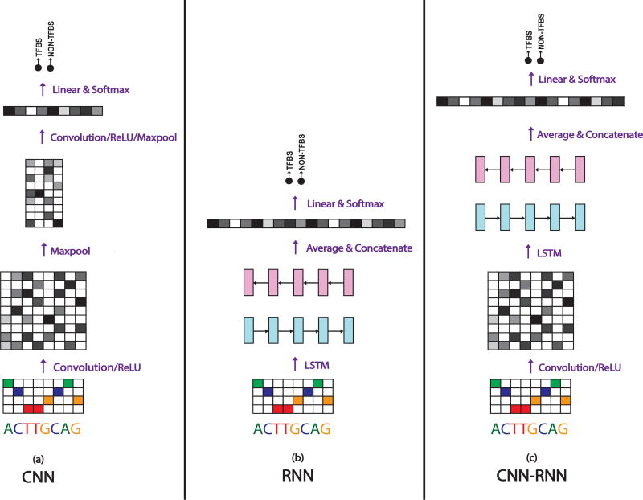
Computational approach
Motif discovery, DeepBind (2015)
ENCODE-DREAM Challenge
The state of the surrounding chromosome, the TF and TF-cofactor expression and other contextual factors play an equally large role
Top-performing methods from the ENCODE-DREAM Challenge typically adopt the single-task learning approach
The multitask solution adopted by DeepSea involves training a multiclass classifier on DNA sequences
Each class represents the occurrence of binding sites for one TF in one cell type
Generalize predictions beyond the TF and cell-type pairs
Low resolution vs low context size
TF binding sites are typically only 4–20 bp long
Lanchantin, J., Singh, R., Wang, B. & Qi, Y. DEEP MOTIF DASHBOARD: VISUALIZING AND UNDERSTANDING GENOMIC SEQUENCES USING DEEP NEURAL NETWORKS. Pac Symp Biocomput 22, 254–265 (2017).
Notes:
Catchitt (Keilwagen et al., 2019), achieves top performance by leveraging a wide range of features including DNA sequences, genome annotations, TF motifs, DNase-seq, and RNA-seq.

Slide 5
Motivation
Need multitask learning framework for base-pair resolution prediction of cell-type-specific TF binding sites
Jointly trains on multiple cell types and TFs, achieves base-pair resolution predictions and accepts input sequences up to 1 kb.

Slide 6
Related work
DeepBind(2015)
Use CNN find out dna pattern for binding region
Deeperbind
Base-pair resolution detection of transcription factor binding site
BindSpace(2019)
High dimensional embedding

Slide 7
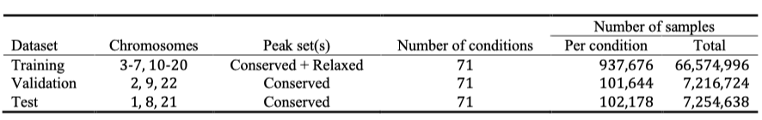
Data
71 ChIP-Seq data from ENCODE
7 cell type
3 cancer, 3 normal, 1 stem cell
22 TF
17 TF from 5 TF-family
5 functionally related TF
Cell-type specific data
DNase, H3K4me1, H3K4me3, H3K27ac
Notes:
[K, L] –> [4d, L] –>

Slide 8
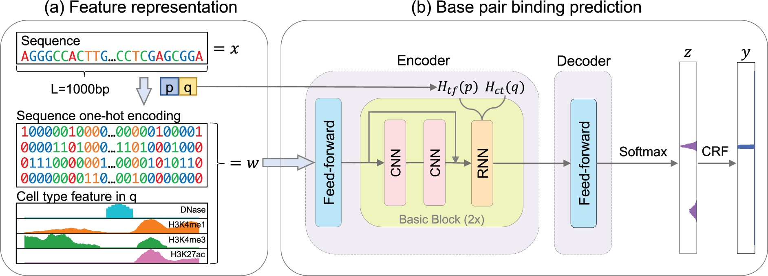
Tech_autoencoder
Encoder – Mapping input feature w to a hidden vector h ∈ ℝ^{2d×L} , d = 50
Decoder – Fully connected layer
Minimizing the negative conditional log-likelihood of z

Slide 9
Tech_Feature embed
Sequence:
one-hot encoder
cell type:
DNase, H3K4me1, H3K4me3, H3K27ac datas
Use the area with signal value big

Slide 10
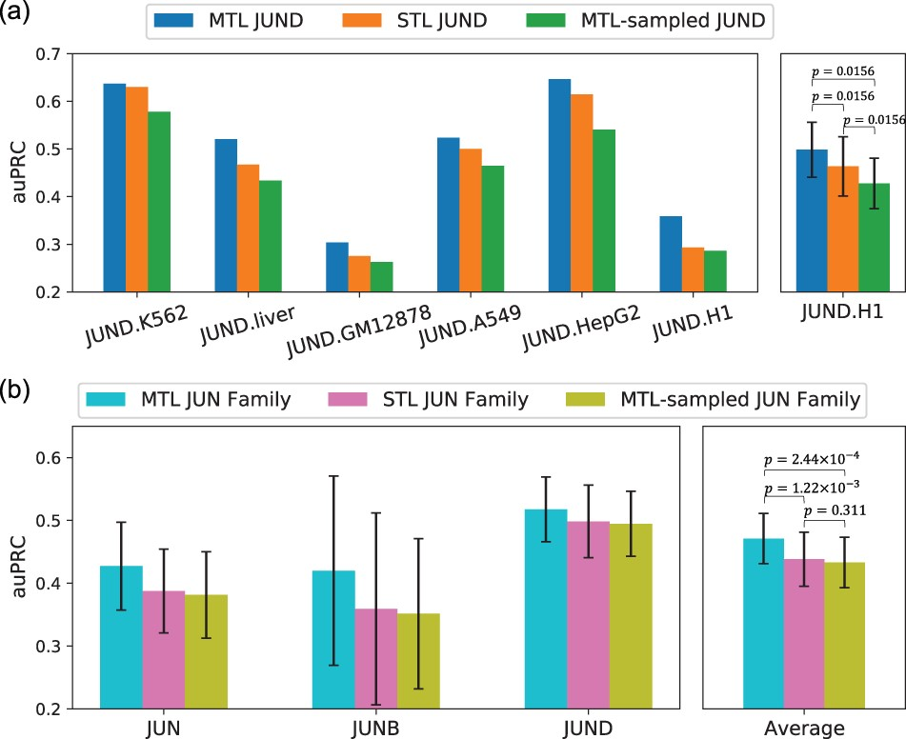
Results – Multitask learning improves performance
The proposed methods could adopt
single condition (single-task learning)
multiple conditions (multitask learning)
Combining multiple cell types of JUND allows the multitask learning model to significantly outperform
Decreased performance when subsampling the multitask models’ training data

Slide 11
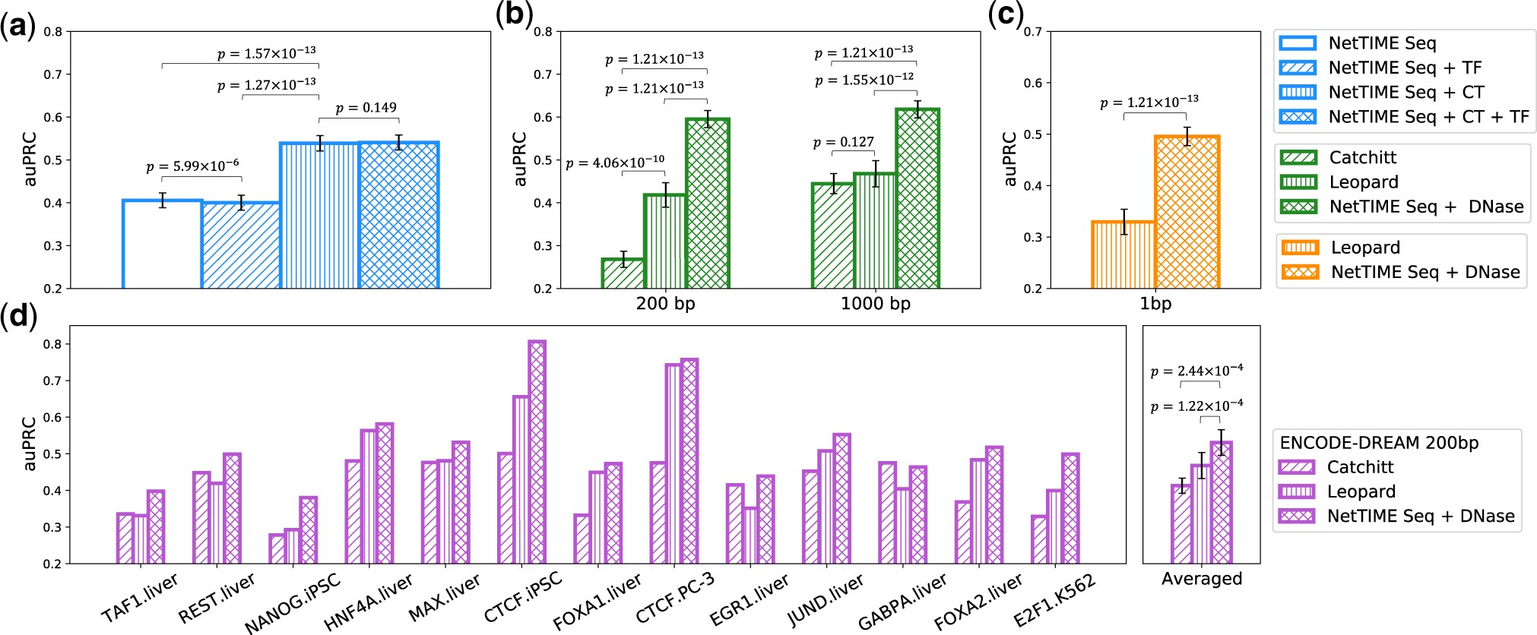
Results – NetTIME performance

Slide 12
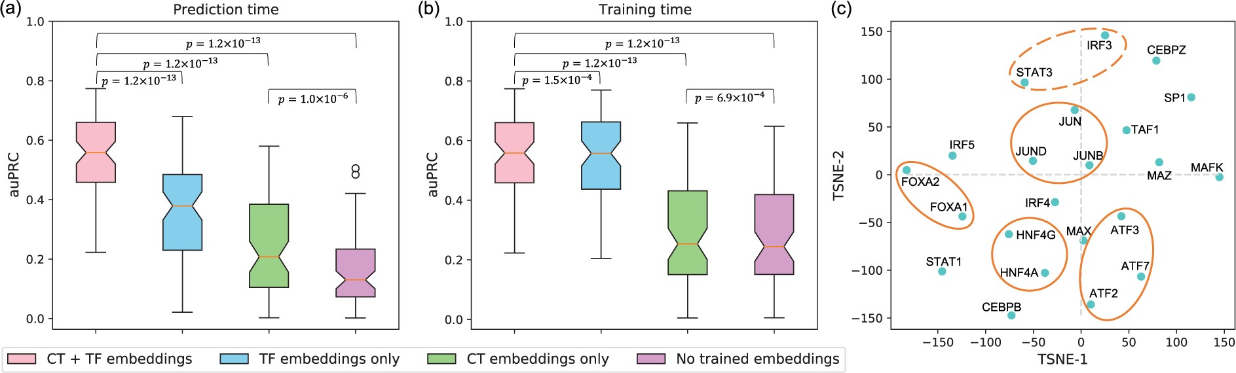
Results – Embedding
TF- and cell-type-specific embeddings are crucial
Some TFs that are in close proximity in t-SNE space are from the same TF families

Slide 13
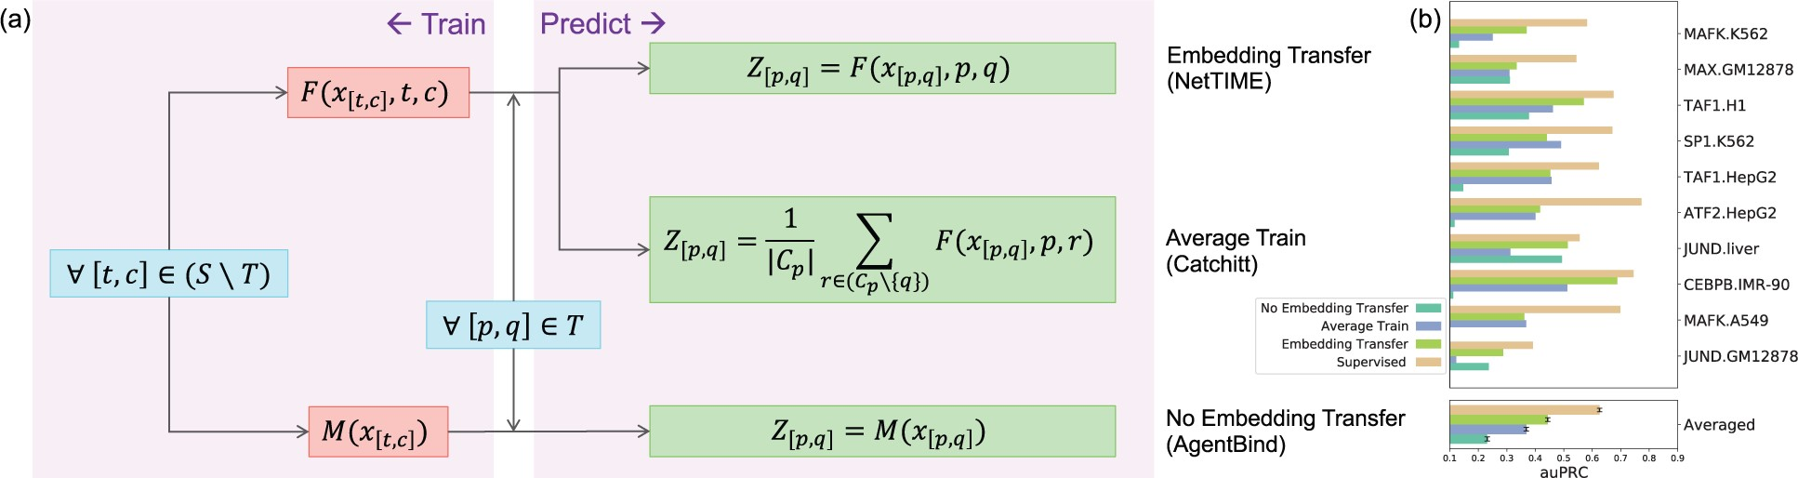
Results – Transfer learning
Different transfer learning scheme
pretrain a NetTIME model by leaving out 10 conditions for transfer learning
Transfer learning predictions are generally less accurate than supervised

Slide 14
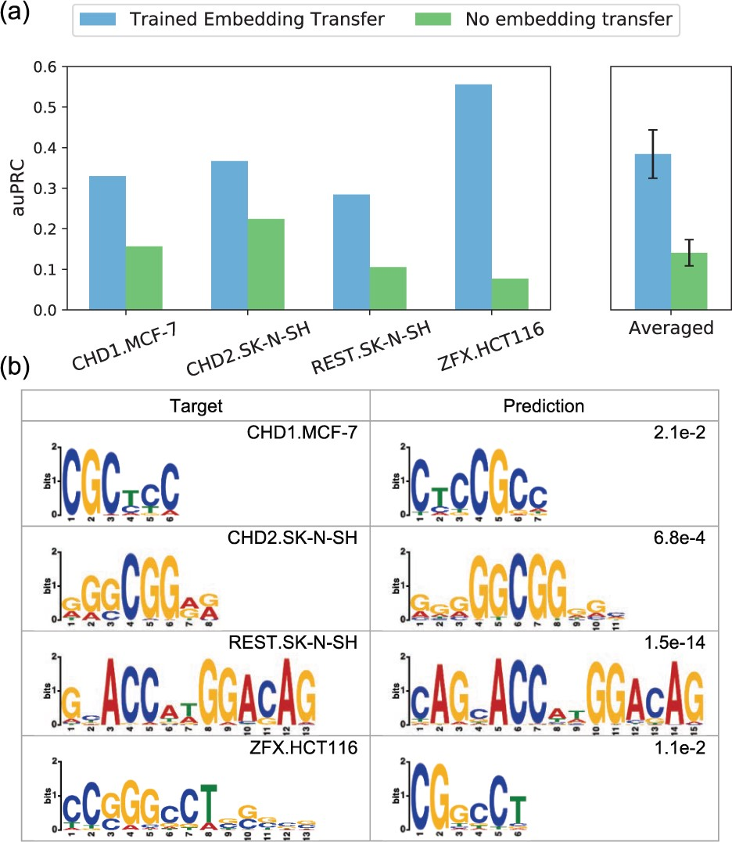
Results – Transfer learning
Allow predictions beyond the training condition
four new TFs in three new cell types
Binding motifs derived from predicted binding sites

Slide 15
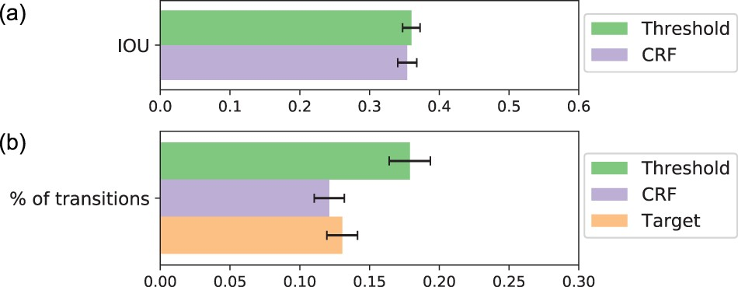
Results – Additional CRF classifier
Evaluating the model’s predictive performance at 300 randomly selected probability thresholds.
At threshold 0.1302, the model achieves the highest IOU score of 36%
CRF (Conditional Random Fields) is more effective at reducing prediction noise

Slide 16
Discussion
Introducing a multitask learning framework – NetTIME
Multitask learning approach improves prediction accuracy
The use of TF and cell-type embedding vectors additionally allows to make accurate transfer learning
Extensive feature engineering has been the focus of many recent methods
strategies for handling missing features
NetTIME is extensible and can be adapted to improve solutions to other biology problems
transcriptional regulatory network inference
Notes:
learns base-pair resolution TF binding sites using embeddings

